Slide 1
Dataset Distillation
Machine Learning Reading Group
Paper: Dataset Distillation
Authors: Tongzhou Wang, Jun-Yan Zhu, Antonio Torralba, Alexei A. Efros
Presenter JUNLIANG YU
2023/07/26

Slide 2
Model-Centric AI vs Data-Centric AI
Model-centric
Given the data, how can you change the model to improve performance?
Data-centric AI
Given the model, how can you systematically change your data to improve performance?
Notes:
Before we come straight to the point

Slide 3
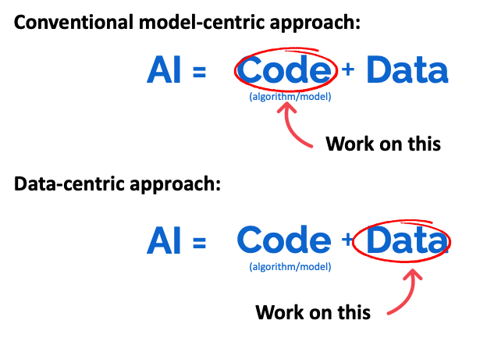
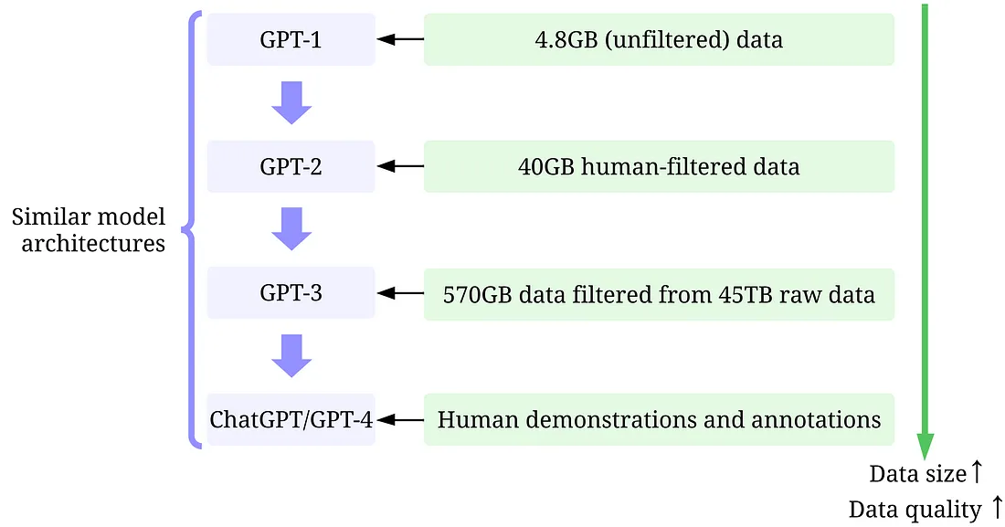
Potential of Data
The potential of data has always been underestimated !
Large and high-quality training data are the driving force of recent successes of GPT models.

Slide 4
Data-Centric AI
An overview of training data development
An overview of inference data development

Slide 5
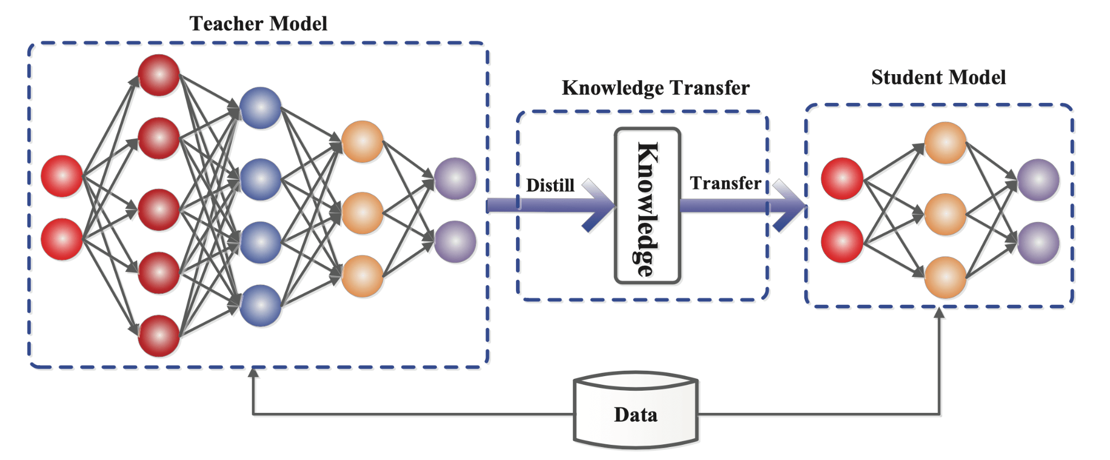
Knowledge Distillation

Slide 6
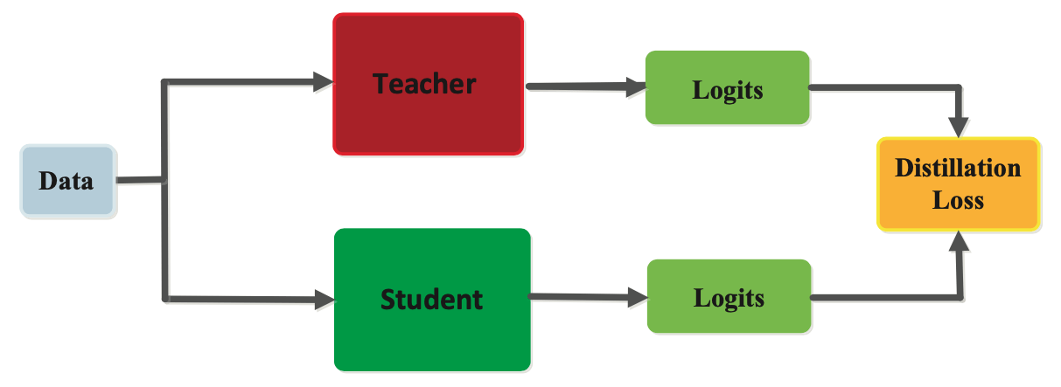
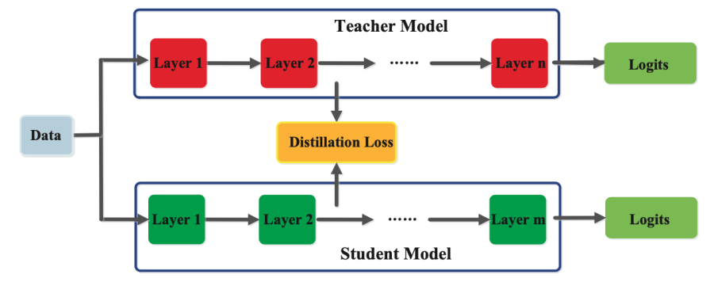
Knowledge Distillation

Slide 7
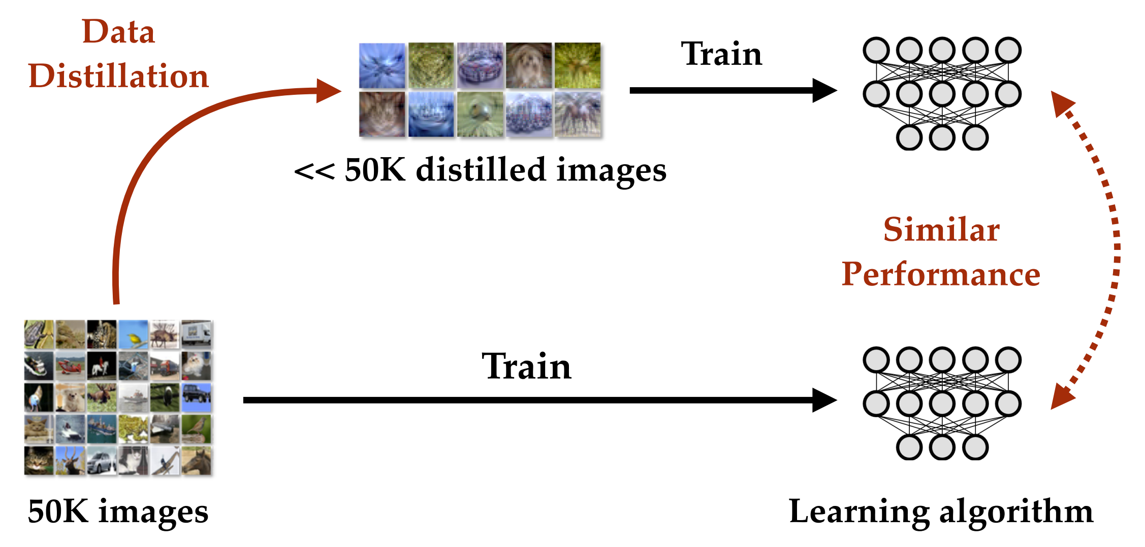
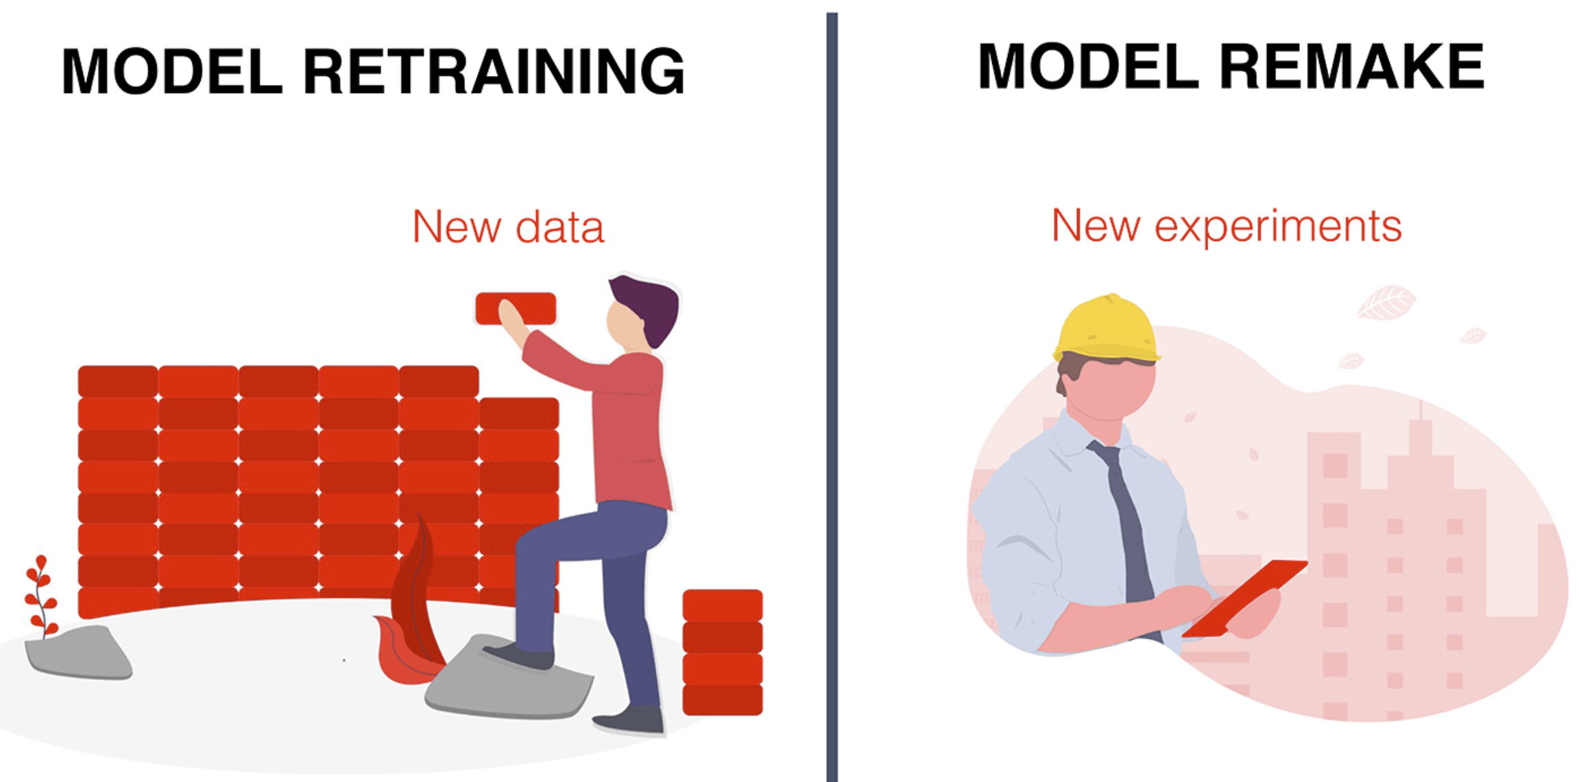
Data Distillation
Issue: Data Explosion→ resource-intensive, slow research iteration, difficult to process, store and transfer
Faster and Cheaper Training !
Data Distillation is to generate a more compact and representative dataset from a larger, more complex one. By distilling the data, models can often achieve similar performance with less resource-intensive training processes.

Slide 8
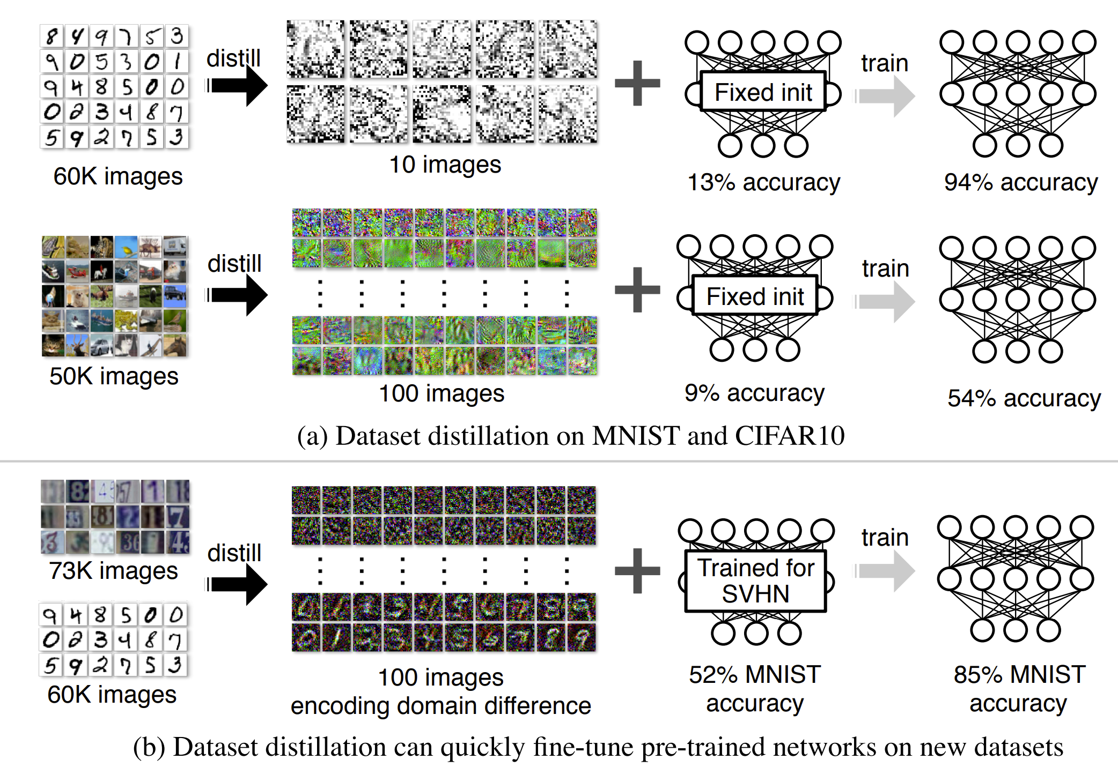
Data Distillation

Slide 9
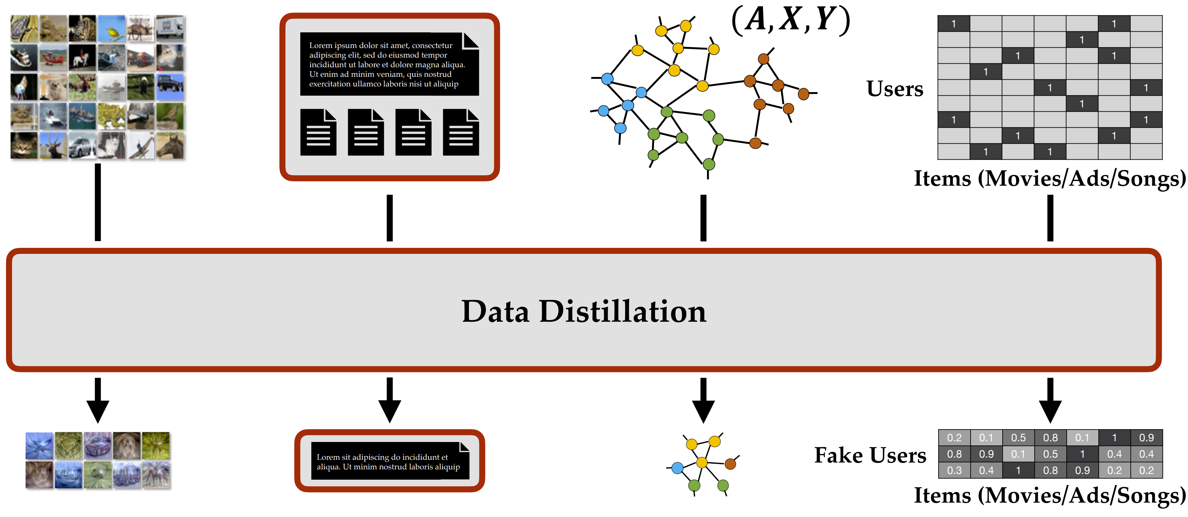

Slide 10
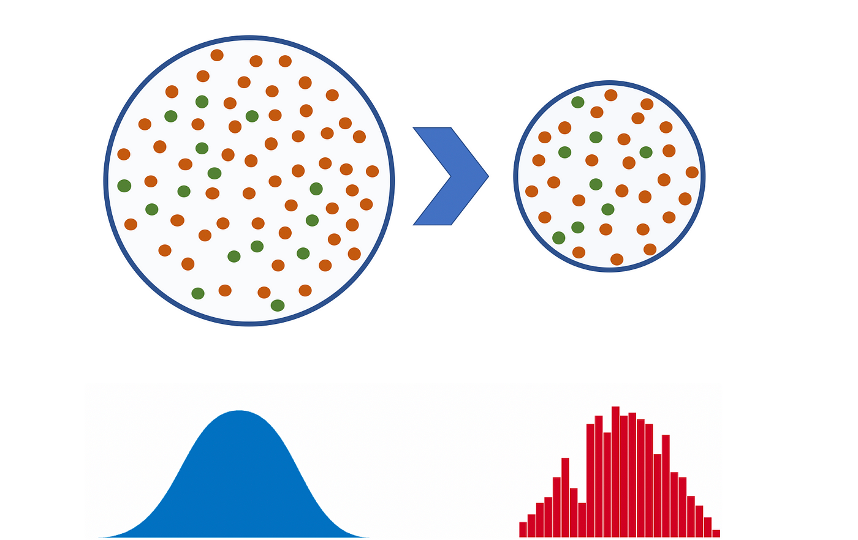
Related Concepts
Dataset pruning, core-set construction, and instance selection
examine the influence of removing a particular set of training samples on model’s generalization ability with theoretical guarantee.
construct the smallest subset of training data
Aims to select a subset of the most
informative training samples

Slide 11
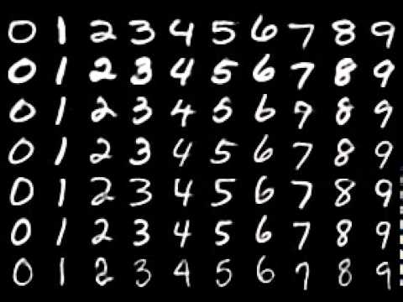
Related Concepts
Core-set selection
Original dataset
Dataset distillation

Slide 12
Objective
Goal: Given a model and a dataset, dataset distillation aims to obtain a new, much-reduced synthetic dataset which performs almost as well as the original dataset.
Conventional model update with SGD
Goal of Dataset Distillation

Slide 13
Objective
The distilled data often look like random noise as it encodes the information of both training dataset x and a particular network initialization.
Distillation with random initializations
Synthetic dataset learned with a fixed initialization cannot generalize to other initializations.

Slide 14
Objective
Distillation with random initializations
Synthetic dataset learned with a fixed initialization cannot generalize to other initializations.
In this way the final distilled data generalize well to unseen initializations

Slide 15
Optimization
Previous works formulate the dataset distillation as a bi-level optimization problem, pose the network parameters θ^{S} as a function of synthetic data S and obtain a solution for S by minimizing the training loss L^{T} over the original data T.
This requires solving a nested loop optimization and unrolling the whole training trajectory of the inner problem, which can be prohibitively expensive.

Slide 16
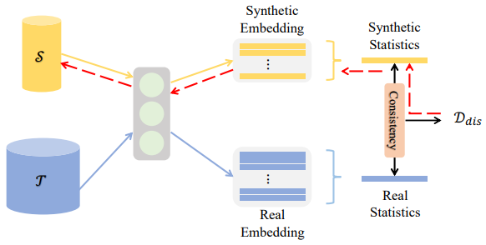
Optimization
Efficient solutions
Two datasets which are similar according to a particular distribution divergence metric (e.g. maximum mean discrepancy), also lead to similarly trained models.
Distribution matching

Slide 17
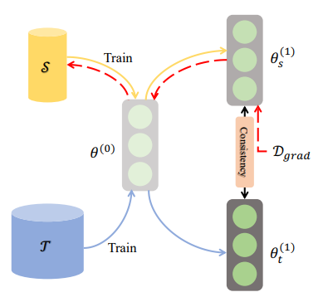
Optimization
Match the network parameters w.r.t. large-real and small-synthetic training data by matching their gradients at each training step. In this way, the training trajectory on small-synthetic data S can mimic that on the large-real data T , i.e., the models trained on these two datasets converge to similar solutions (parameters).
Efficient solutions
Gradient matching

Slide 18
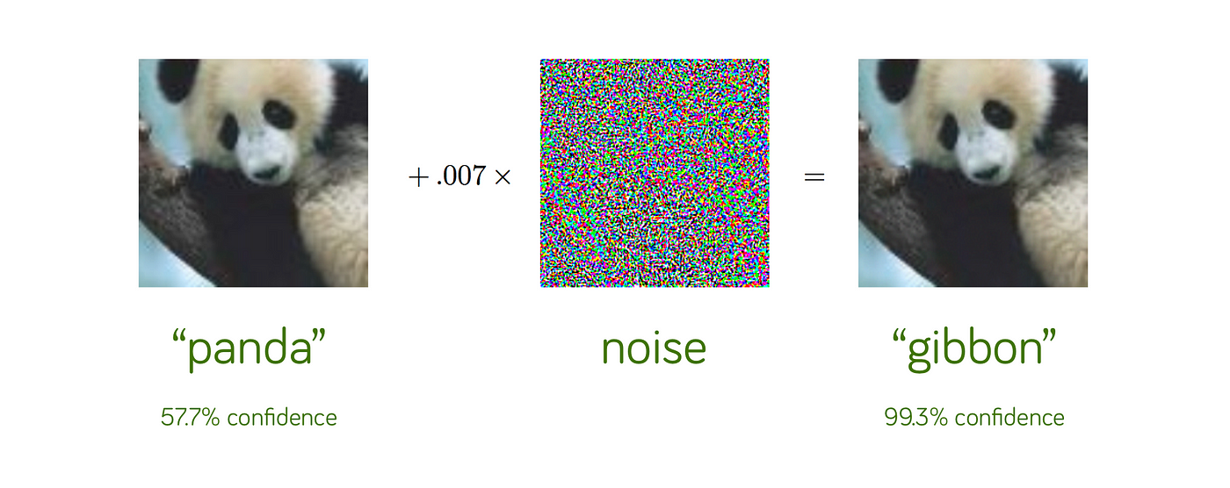
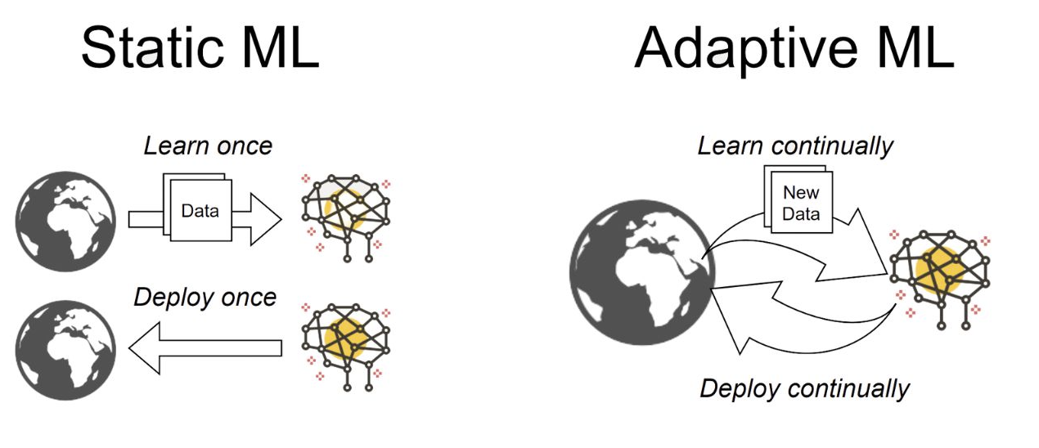
Use of Dataset Distillation
Generate Poisoning Data
Continual Learning

Slide 19
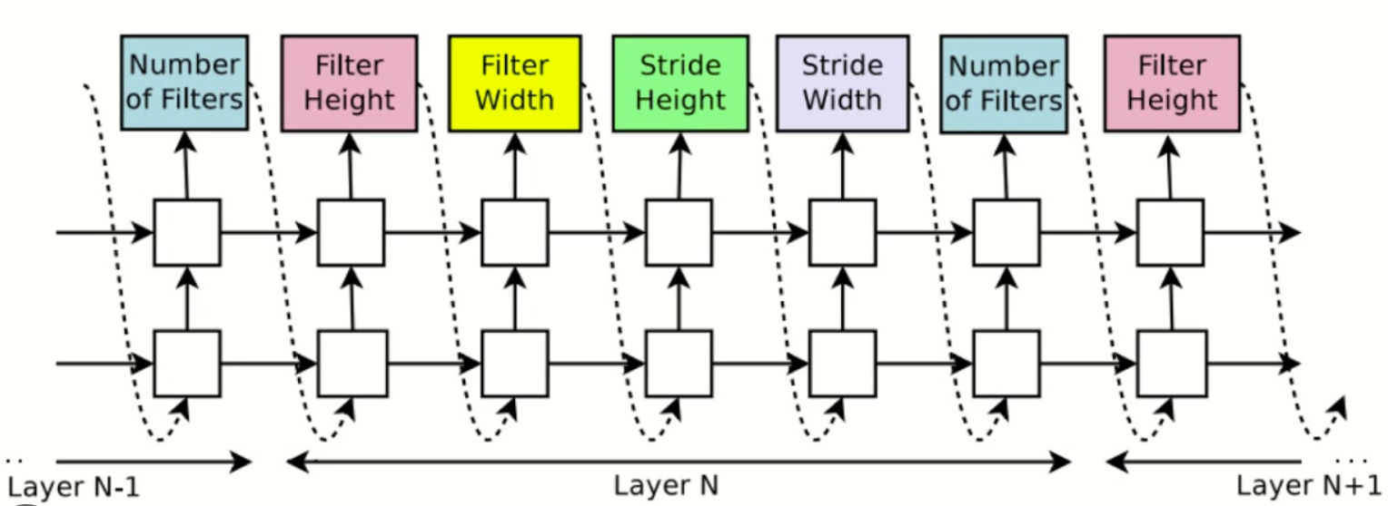
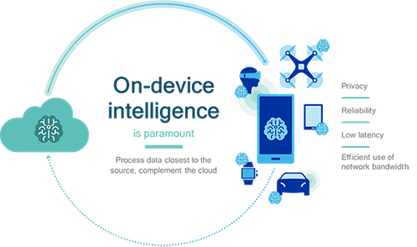
Use of Dataset Distillation
Neural architecture search
On-device Machine Learning

Slide 20
Challenges
What if multiple variables are required to learn? E.g. node features and adjacency matrix
What if the data to be distilled is discrete?
How to avoid that the distilled dataset only learns the dominant pattern in the original dataset?

